Slide 1
FACIAL EMOTION DETECTION
GUIDE DETAILS:
Mrs.A.Bhanusri
M.Tech,(Ph.D)
Assistant Professor
Department of IT
STUDENT DETAILS:
P.AKHIL
22331A1284

Slide 2
ABSTRACT
The project aims to classify facial expressions into distinct emotion categories, such as happiness, sadness, anger, surprise,fear, and neutrality, by analyzing facial features in video streams by machine learning techniques, particularly deep learning. The system will support real-time emotion detection using a webcam feed, providing instant feedback on detected emotions. The project aims to improve emotion recognition accuracy and provide a scalable solution for applications in human-computer interaction, sentiment analysis, and customer behavior assessment.

Slide 3
PROBLEM STATEMENT
In the modern era of human-computer interaction, understanding and interpreting human emotions is essential for creating responsive systems. We need to Overcome the limitations of traditional methods and provide a scalable and efficient solution which is Facial emotion detection. This facial emotion detection system is capable of classifying emotions in real-time video streams.

Slide 4
INTRODUCTION
Emotions are essential in human communication, influencing interactions, decisions, and behaviors. Recognizing emotions accurately can enhance applications like human-computer interaction, mental health monitoring, and customer experience analysis. Deep learning, has significantly improved facial emotion recognition accuracy. This system will classify emotions such as happiness, sadness, anger, surprise, fear, and neutrality.

Slide 5
SYSTEM REQUIREMENTS
1. Hardware Requirements:
Processor: Intel Core i5/i7 or AMD Ryzen 5/7
RAM: Minimum 8GB (16GB recommended for faster processing)
Camera: HD webcam for real-time video processing
2. Software Requirements:
Operating System: Windows 10/11, Linux (Ubuntu recommended)
Programming Languages: Python, HTML, CSS, JS.
Libraries & Frameworks: OpenCV, NumPy, TensorFlow, Matplotlib
Development Tools: Jupyter Notebook, VS Code

Slide 6
EXISTING SYSTEM
Current facial emotion detection systems process only static images, lacking real-time recognition capabilities. The user interfaces are often basic and not visually appealing. Additionally, older and less diverse datasets affect the models' ability to generalize well. These limitations reduce the effectiveness of emotion detection in real-world applications.

Slide 7
PROPOSED SYSTEM
The proposed system utilizes a Real-time emotion detection via webcam allows for applications in HCI, sentiment analysis, and behavior assessment. The UI will be redesigned for a more professional and visually appealing experience. Performance optimizations, including GPU acceleration, will ensure smooth and efficient real-time predictions. These improvements will create a more reliable, accurate, and user-friendly emotion detection system.

Slide 8
METHODOLOGY
INPUT FACE
FACE DETECTION
FEATURE EXTRACTION
EMOTION CLASSIFICATION
DISPLAYING EMOTION

Slide 9
IMPLEMENTATION PROCEDURE
Data Collection & Preprocessing: Use datasets like FER-2013, apply augmentation, and normalize images.
Face Detection: Detect faces in images and video using OpenCV’s Haar cascades
Feature Extraction: Extract facial landmarks or use CNN for automatic feature learning.
Real-time Processing: Capture live video, detect faces, and classify emotions using the trained model.
Output Display: Overlay detected emotions on the video feed with bounding boxes.
Deployment: Use Flask to create a web-based application for user interaction.

Slide 10
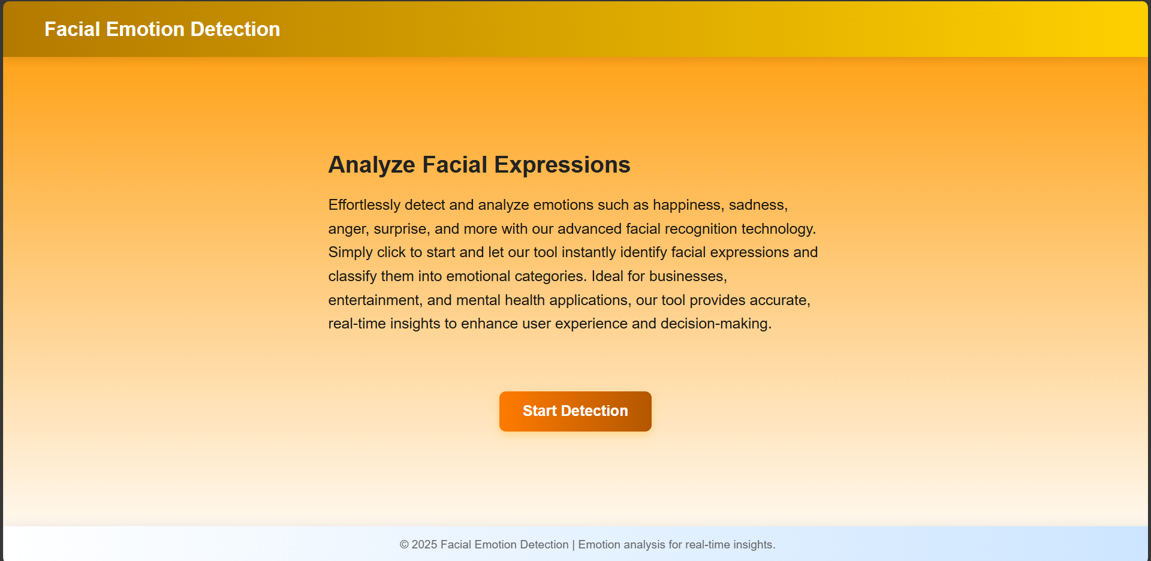
RESULT

Slide 11
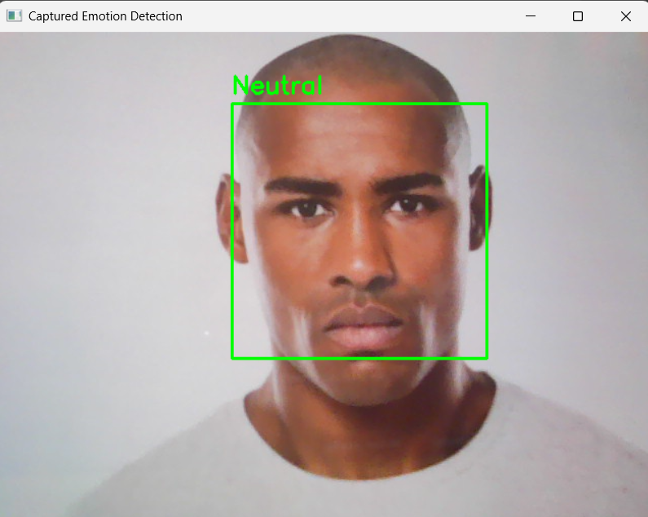
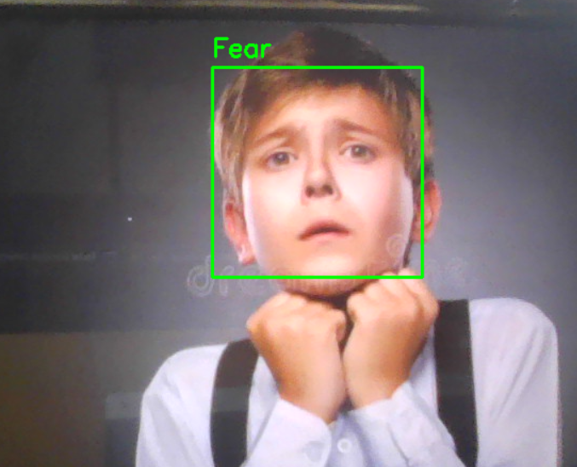
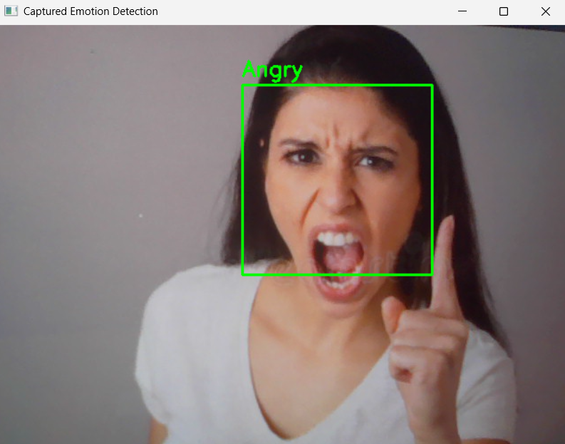

Slide 12
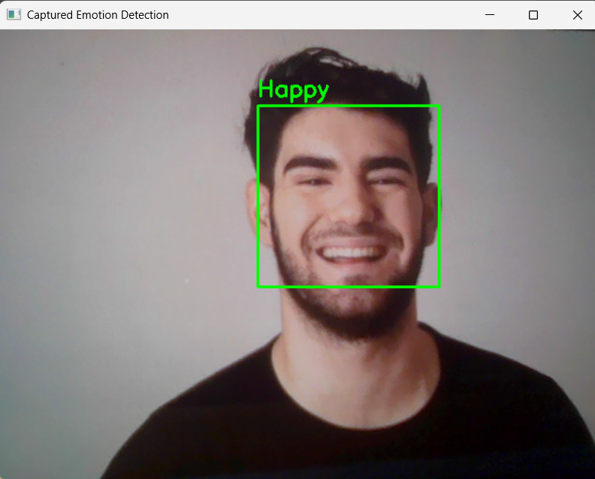
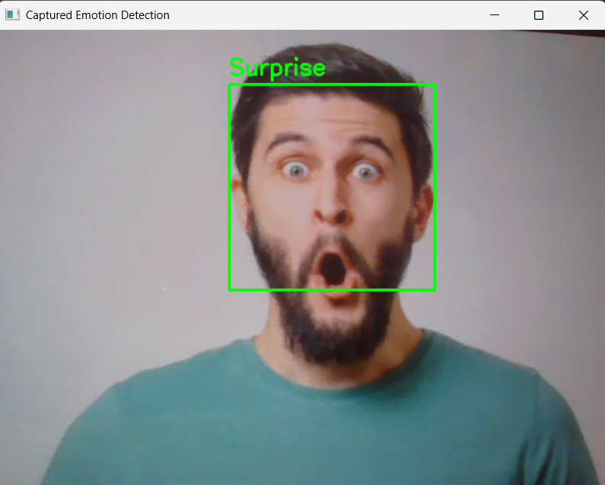
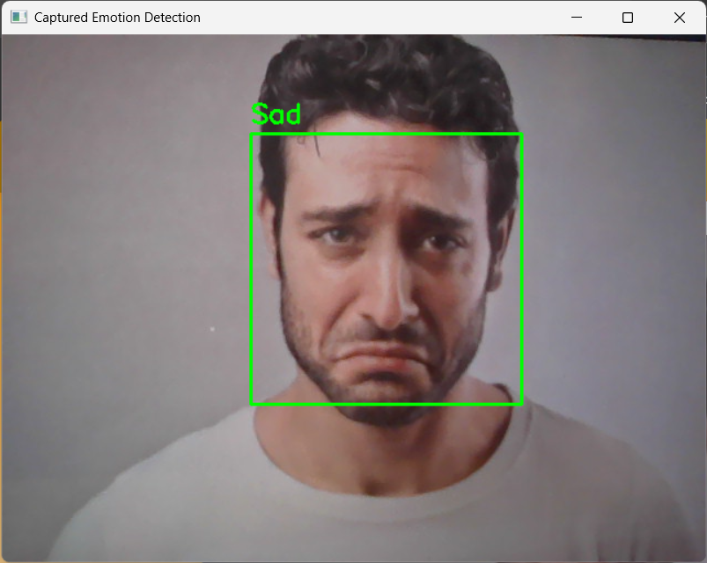

Slide 13
ADVANTAGES
Enhancing Human-Computer Interaction (HCI)
Applications in Mental Health
Security and Surveillance
Improved Market Research
Enhanced Customer Service
Education and Training
Real-Time Feedback

Slide 14
LIMITATIONS
Accuracy Issues
Environmental Factors
Cultural Differences
Inability to Detect Complex Emotions
Impact of Aging

Slide 15
CONCLUSION
In conclusion, facial emotion detection technology holds significant potential in transforming various industries, from healthcare and education to entertainment and market research. By providing valuable insights into human emotional states, this technology can enhance user experiences, improve interaction between humans and machines, and offer new opportunities for personalized services.

Slide 16
REFERENCES
[1]. W3Schools Online Web Tutorials
[2]. Learn Flask | Codecademy
[3]. Learn Python - Free Interactive Python Tutorial
[4]. Facial Emotion Recognition Using Transfer Learning in the Deep CNN
[5]. Facial Emotion Recognition (FER) using Convolutional Neural Network (CNN) - ScienceDirect

